Slide 1
Array
Introduction to Array
Declaration and Initialization
Accessing Elements of an Array
Operations with an Array
Search
Insertion and
Deletion
Two Dimensional Array
String
Declaration and Initialization
Access, Input and Output
String Handling Functions

Slide 2
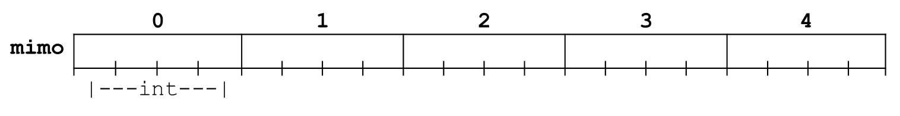
Array
An array can hold a series of elements of the same type placed in contiguous memory locations.
Each of these elements can be individually referenced by using an index to a unique identifier.
In other words, arrays are a convenient way of grouping a lot of values of same type under a single variable name.
For example, an array to contain 5 integer values of type int called mimo could be represented like this:
where each blank panel represents an element of the array, that in this case are integer values of type int with size 4 bytes. These elements are numbered/indexed from 0 to 4 since in arrays the first index is always 0, independently of its length.

Slide 3
Array: Declaration
Like a regular variable, an array must be declared before it is used. A typical declaration for an array is as follows:
type name [total_number_of_elements];
where type is a valid data type (like int, float …), name is a valid identifier and the elements field (which is always enclosed in square brackets []), specifies how many of these elements the array can contain.
Therefore, in order to declare an array called mimo as the one shown in the above diagram it is as simple as:
int mimo [5];
The elements field within brackets [] which represents the number of elements the array is going to hold, must be a constant integer value, since arrays are blocks of non-dynamic memory whose size must be determined before execution.

Slide 4
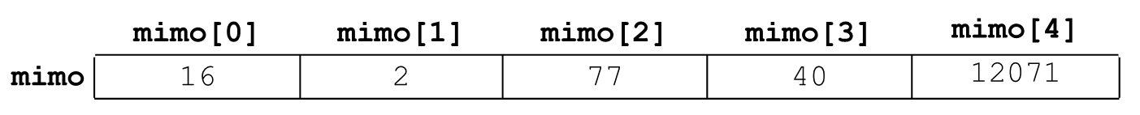
Array: Initialization
When declaring a regular array (int mimo[5];) of local scope (within a function, for example) its elements will not be initialized to any value by default, so their content will be undetermined until we store some value in them.
When we declare an array, we have the possibility to assign initial values to each one of its elements by enclosing the values in braces { } separated by comas.
For example: int mimo[5] = { 16, 2, 77, 40, 12071 };
This declaration would have created an array like this:
The number of values between braces { } must not be larger than the number of elements that we declare for the array between square brackets [ ].

Slide 5
Array: Initialization
An array can also be partially initialized. i.e. we assign values to some of the initial elements. For example: int mimo[9] = { 16, 2, 77, 40, 12071 };
This declaration would have created an array like this:
Here the first 5 values are assigned sequentially. The rest 4 elements are unassigned.
Some more initialization –
float x[5] = {5.6, 5.7, 5.8, 5.9, 6.1};
char vowel[6] = {'a', 'e', 'i', 'o', 'u', ‘\0'};
is equivalent to string declaration: char vowel[6] = "aeiou";

Slide 6
Array: Accessing Element
The number in the square brackets [ ] of the array is referred to as the 'index' (plural: indices) or 'subscript' of the array and it must be an integer number 0 to one less than the declared number of elements.
We can access the value of any of its elements individually as if it was a normal variable, thus being able to both read and modify its value. The format is as simple as: name[index]
For the declaration int mimo[5]; the five (5) elements in mimo is referred in the program by writing: mimo[0] mimo[1] mimo[2] mimo[3] mimo[4]
Each of the above array elements is an integer and each of them also acts as an integer variable. That is, whatever operation we can perform with an integer variable we can do the same with these array elements using same set of rules.

Slide 7
Array: Accessing Element
How the address of a particular element at index i is calculated?
Address of a[i] = ?
Address of a[i] = Base address + i * size of an element in memory
Depends on data type
Address of first element (&a[0])

Slide 8
Array : Accessing Element
Arrays have a natural partner in programs: the for loop. The for loop provides a simple way of counting through the numbers of an index in a controlled way. The for loop can be used to work on an array sequentially at any time during a program.
It is important to be able to clearly distinguish between the two uses that brackets [ ] have related to arrays.
one is to specify the size of arrays when they are declared - char array[5]; Here the index (5) is always an integer constant.
the second one is to specify indices for concrete array elements - array[3] = '*'; Here the index (3) is always an integer or an integer expression.
Consider the following example:
char array[5];
array[7] = '*';
The assignment of array[7] is clearly wrong as index 7 or element 8 in array[5] does not exists.

Slide 9
Array : Accessing Element (Example)
int mimo[5], a, b, i; // declaration of a new array
mimo[2] = 75; // store 75 in the third element of mimo
a = mimo[2]; // copy/assign a with the third value of mimo
scanf("%d",&mimo[2]); // read a value for the third element of mimo
// read 5 values for the five elements of mimo sequentially
for(i=0; i<5; i++)
scanf("%d",&mimo[i]);
// print 5 values for the five elements of mimo sequentially
for(i=0; i<5; i++)
printf("%d\n",mimo[i]);
// some more interesting accesses
a = 4;
mimo[2] = a;
mimo[a] = 3;
b = mimo[a-2] + 2; //use of expression in index
mimo[mimo[a]] = mimo[2] + b;

Slide 10
Operation on Array - Searching
Algorithm:
Input: Array, #elements, item (to search)
Start with the element at index = 0
Step 1: Compare the element at index with item. If its equal to item then return index with status “Found” otherwise go to step 2.
Step 2: Increase index by 1. If index is less than #elements go to step 1 otherwise return -1 with status “Not found”.

Slide 11
Operation on Array - Insertion
Algorithm:
Input: Array, #elements, item (to insert), position
Step 1 [Shifting]: If position is less than #elements then
shift each element to right by one position [starting from the last till the element at position]
Step 2 [Inserting]: Store item at position
Step 3: Increase #elements by 1

Slide 12
Operation on Array - Insertion
int k, i, n=5, mimo[10]={2, 3, 5, 6, 7}; //partial initialization; n=total elements
mimo[n++] = 8; // insert value 8 at the end of the array; increase n;
// insert value 1 at the beginning of array
for(i=n; i>0; i--) //shift all the values one index forward. i.e. the value
mimo[i] = mimo[i-1]; //in index 1 goes to 2, 2 goes to 3,…, (n-1)^{th} goes to n^{th}.
mimo[0] = 1; n++; //1 is inserted at index 1; n increases;
// insert value 4 in the middle (index k=3) of the array
k = 3;
for(i=n; i>k; i--) //shift all the values one index forward. i.e. the value
mimo[i] = mimo[i-1]; //in index k goes to k+1,…, (n-1)^{th} goes to n^{th}.
mimo[k] = 4; n++; //4 is inserted at index k; n increases;
for(i=0; i<n; i++) //printing all the values in the array after insert
printf("%d “,mimo[i]);
OUTPUT:
1 2 3 4 5 6 7 8
6
i
1
5
0
4
8
7
i
2
3
mimo |  |  |  |  |  |  |  |  |  | 9 |  |  |  | k
0
1
2
3
4
5
6
7
8
n
2
3
4
7
3
1
6
7
8
6
2
3
5
5
6
6
7
8
5
5
7
8
8

Slide 13
Operation on Array - Deletion
Algorithm:
Input: Array, #elements, position (to delete)
Step 1 [Store the item]: store the value at position to a variable
Step 2 [Shifting]: If position is less than #elements-1 then
shift each element to left by one position [starting from the element at position+1 till the last element]
Step 3: Decrease #elements by 1

Slide 14
Operation on Array - Deletion
int k, i, n=8, mimo[10]={1, 2, 3, 4, 5, 6, 7, 8}; //n=total elements.
n--; // decrease n; last element 8 is no longer part of list.
// delete value 1 from the beginning of array.
n--; // deleting the value 1 will decrease the total elements n by one.
for(i=0; i<n; i++) //shift all the values one index backward. The value in index
mimo[i] = mimo[i+1]; //2 goes to 1, 3 goes to 2,…, n^{th} goes to (n-1)^{th}.
k = 2; // delete value 4 from the middle (index k=2) of the array
n--; // deleting the value 4 will decrease the total elements n by one.
for(i=k; i<n; i++) //shift all the values one index forward. i.e. the value
mimo[i] = mimo[i-1]; //in index k+1 goes to k,…, n^{th} goes to (n-1)^{th}.
for(i=0; i<n; i++) //printing all the values in the array after insert
printf("%d ", mimo[i]);
OUTPUT:
2 3 5 6 7
i
1
6
2
3
4
0
5
0
1
2
3
4
n
mimo |  |  |  |  |  |  |  |  | 8 | 9 |  |  |  | k
5
6
7
5
2
3
6
1
2
4
6
4
7
6
2
5
5
6
8
8
3
7
7
5
7

Slide 15
Multidimensional Array and Parallel Array
Multidimensional arrays have more than one dimension
All data rows stay together in memory
Parallel arrays are homogeneous data arrays for each field of the record, each having the same number of elements.
Data rows are implemented as separate arrays.
Example of Parallel Array
int ages[] = {0, 17, 2, 52, 25};
char *names[] = {"None", "Mike", "Billy", "Tom", "Stan"};
int parent[] = {0 /*None*/, 3 /*Tom*/, 1 /*Mike*/, 0 /*None*/, 3 /*Tom*/}; for(i = 1; i <= 4; i++) {
printf("Name: %s, Age: %d, Parent: %s \n", names[i], ages[i], names[parent[i]]);
}

Slide 16
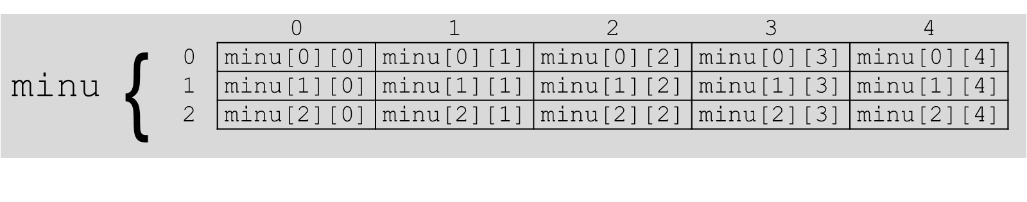
Two Dimensional (2D) Array
Two-dimensional arrays can be described as "arrays of arrays". For example, a 2D array can be imagined as a Two-dimensional table made of elements of same uniform data type.
minu represents a Two-dimensional array of 3 per 5 elements of type int. The way to declare this array would be: int minu [3][5];
The way to reference the 2nd element vertically and 4th horizontally or the (2 × 4) 8th element in an expression would be: minu [1][3];
Generally, for two-dimensional array, 1st dimension is considered as row and the 2nd dimension is considered as column. Here, we have 3 rows and 5 columns.

Slide 17
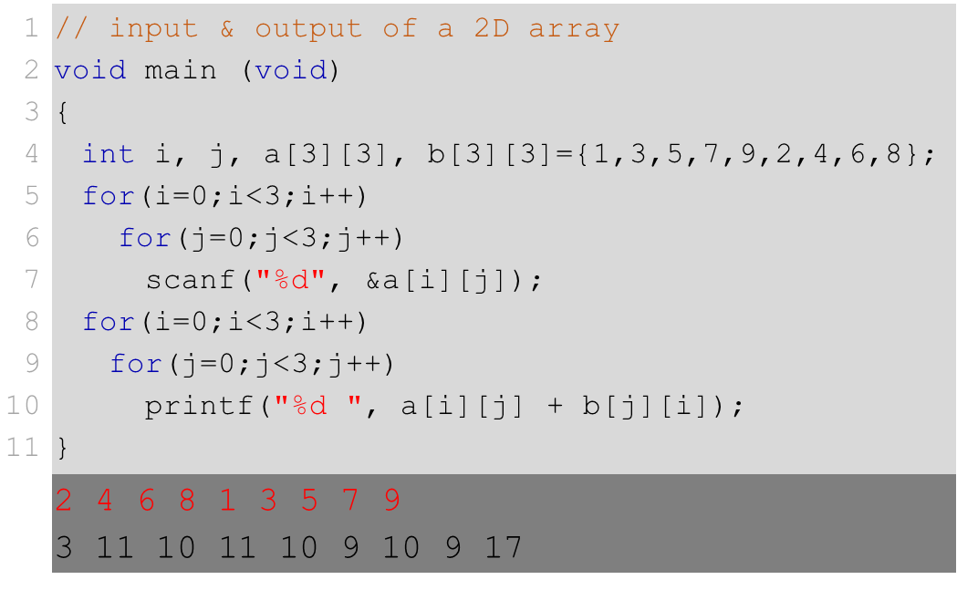
2D Array: Access Element
Nested loop is used to take input and give output.
The input is taken in row (1st dimension) major. i.e. all the values of row 0 is scanned first, then the values of row 1, and values of row 2. For each row, value at column 0 is scanned first, then the value at column 1, and value at column 2.
In output, array a is used in row major. But array b is used in column (2nd dimension) major. i.e. all the values of column 0 is added first, then the values of column 1, and values of column 2. For each column, value at row 0 is added first, then the value at row 1, and value at row 2.
Consider the following example (the dark rea at the end is the output of this program; the red colored text represents input given by the user):

Slide 18
Memory Access
Two-dimensional arrays are just an abstraction for programmers, since we can obtain the same results with a simple array just by putting a factor between its indices: int minu [3][5]; is equivalent to (3 * 5 = 15); int minu [15];
2D Array
1D array
int minu [3][5], H=3, W=5, n, m, i=0;
void main (void){
for (n=0; n<H; n++)
for (m=0; m<W; m++)
minu [n][m]= ++i;
}
int minu [3 * 5], H=3, W=5, n, m, i=0;
void main (void){
for (n=0; n<H; n++)
for (m=0; m<W; m++)
minu [ W * n + m ] = ++i;
}
 | 0 | 1 | 2 | 3 | 4
0 | 1 | 2 | 3 | 4 | 5
1 | 6 | 7 | 8 | 9 | 10
2 | 11 | 12 | 13 | 14 | 15
As memory is flat, in both codes the values are actually stored sequentially in the memory (just like the 1D array). The access for the two-dimensional array in that case is just as the indexing of the array,
[(row_index) * (Total_column) + (column_index)]
 | 0 | 1 | 2 | 3 | 4 | 5 | 6 | 7 | 8 | 9 | 10 | 11 | 12 | 13 | 14
 | 1 | 2 | 3 | 4 | 5 | 6 | 7 | 8 | 9 | 10 | 11 | 12 | 13 | 14 | 15
Height
Width
n
m
Width * n + m
3
5
0
2
2
2
1
0
6
9
3
5
0
3
7
1
8
14
4
13
1
4
11
12
10

Slide 19
Memory Access
Memory of each element of an array can be accessed using the & operator.
&mimo[2] gives the memory location of the 3rd element of the array mimo.
If the element is more than a byte, it gives the starting byte of the element.
Let consider the starting address of int mimo[5] is 567.
&mimo[2] will give us the memory location 575.
mimo[2] will give us 4 bytes (int) of information starting from 575 to 579.
The name of an array always refer to the starting location of the array. i.e. the first element of the array. So, mimo = &mimo[0].
 | 0 |  |  |  | 1 |  |  |  | 2 |  |  |  | 3 |  |  |  | 4
mimo
567 |  | 569 |  | 571 |  | 573 |  | 575 |  | 577 |  | 579 |  | 581 |  | 583 |  | 585 |  | 587
 | 568 |  | 570 |  | 572 |  | 574 |  | 576 |  | 578 |  | 580 |  | 582 |  | 584 |  | 586

Slide 20
Memory Access
&mimo[2] will give us the memory location 575.
mimo[2] will give us 4 bytes (int) of information starting from 575 to 578.
The name of an array always refer to the starting location of the array. i.e. the first element of the array. So, mimo = &mimo[0].
&array[index]=start_location_array + index * size_of_data
&mimo[ 2 ] = mimo (or &mimo[0]) + 2 * sizeof(int)
&mimo[ 2 ] = 567 + 2 * 4 = 575
 | 0 |  |  |  | 1 |  |  |  | 2 |  |  |  | 3 |  |  |  | 4
mimo
567 |  | 569 |  | 571 |  | 573 |  | 575 |  | 577 |  | 579 |  | 581 |  | 583 |  | 585 |  | 587
 | 568 |  | 570 |  | 572 |  | 574 |  | 576 |  | 578 |  | 580 |  | 582 |  | 584 |  | 586

Slide 21
Memory Access
567 |  |  | 571 |  |  |  | 575 |  |  |  | 579
 | 0 |  |  |  | 1 |  |  |  | 2
0
1
 |  |  |  |  | ←583 |  |  |  | ←587
579→
2
3
Consider a 2D array mimo[R][C] each element addressed by &mimo[i][j], where R=total element in 1st dimension, C=total element in 2nd dimension, 0≤ i < R, 0 ≤ j < C.
Let int mimo[4][3]; Here, mimo or &mimo[0][0] gives us the starting memory location 567.
mimo[1][1] will give us 4 bytes (int) of information starting from 583 to 587.
 | 0 |  |  |  | 1 |  |  |  | 2 |  |  |  | 3 |  |  |  | 4
mimo
567 |  | 569 |  | 571 |  | 573 |  | 575 |  | 577 |  | 579 |  | 581 |  | 583 |  | 585 |  | 587
 | 568 |  | 570 |  | 572 |  | 574 |  | 576 |  | 578 |  | 580 |  | 582 |  | 584 |  | 586
&array[i][j]=start_location + (i * (C * size_of_data)) + (j * size_of_data)
&mimo[1][1] = mimo + (1 * (3 * sizeof(int))) + (1 * sizeof(int))
&mimo[1][1] = 567 + (1 * 3 * 4) + (1 * 4) = 583

Slide 22
Memory Access
There is a general way to access the memory location of a 2 dimensional array.
For an array int mimo[R][C]; and 0≤i<R; 0≤j<C.
mimo[i] = &mimo[0][j] represents the starting address of i^{th} row.
mimo[i] skips i number of rows each with C number of elements from the start_location of the array.
So, mimo[i] = start_location + (i * C elements), where C elements are counted in bytes based on the size_of_data, here int.
So, mimo[i] = start_location + (i * (C * size_of_data)).
So, mimo[i] = mimo(or &mimo[0][0]) + (i * (C *sizeof(int))).
A 2D array is also referred as an array of arrays. i.e. an array of which each element is another array.

Slide 23
String
Strings are sequence of characters representing a piece of text. In programming languages a string is represented as some characters enclosed by double quotes- "This is a string".
A string is mainly declared using an array of characters.
The main difference between a simple array of character and an array of character representing string is the end marker given at the end of a string. The standard library functions can recognize this end marker as being the end of the string.
The end marker is called the zero (or NULL) byte because it is just a byte which contains the value zero: '\0'. Programs rarely gets to see this end marker as most functions which handle strings use it or add it automatically.

Slide 24
String - Declaration & Initialization
Declaration of a string is just an array of characters: char mimo [5];.
But things are different when we initialize during declaration. An array to contain 5 character values ('H', 'e', 'l', 'l', 'o') of type char called mimo could be represented like this: char mimo [5]={ 'H', 'e', 'l', 'l', 'o'};
But, to represent the same text as string in C/C++ double quotation (") is used to bound the text. And, a NULL character is added at the end of the text. So, because of this NULL, we need to declare an additional slot in the array. char mimo [6]= "Hello";
The standard library functions can recognize NULL ('\0') as being the end of the string.
 | 0 |  | 1 |  | 2 |  | 3 |  | 4
mimo | 'H' |  | 'e' |  | 'l' |  | 'l' |  | 'o'
 | |--char--|
 | 0 |  | 1 |  | 2 |  | 3 |  | 4 |  | 5
mimo | 'H' |  | 'e' |  | 'l' |  | 'l' |  | 'o' |  | '\0'
 | |--char--|

Slide 25
String - Access, Input, Output
Consider the following example (the dark area at the end is the output of this program; the red colored text represents input given by the user):
Lines 5-7declares three arrays of characters. First two are initialized as strings with a NULL character at their end.
Line 8 output the string in Question. First parameter in printf has a %s (here s for string), and the second parameter is the array name Question (giving starting address of the array Question).
The same can be found in line 9, where we have scanf with %s and the array FirstName.
In all such cases, the %s indicates a string, a continuous group of characters, that will be processed one after another.
The address indicates the location in the memory from where the processing will start.
The NULL character indicates where the processing will stop for printf.
And for scanf, after the processing (i.e, after the string input) a NULL character is automatically added at the end of the string.
1 2 3 4 5 6 7 8 9 10 | // null-terminated sequences of characters void main (void) { char Question[]="Please, enter first name: "; char Greeting[] = "Hello"; char FirstName[80]; printf("%s", Question); scanf("%s", FirstName); printf("%s, %s!", Greeting, FirstName); }
 | Please, enter first name: John Hello, John!

Slide 26
String - Access, Input, Output…
Instead of asking for the first name only, if we would have asked for the whole name, this program might not work properly. That is, if we would have given input John Rambo instead of only John the output will be as follows –
Please, enter your first name: John Rambo
Hello, John!
Still it shows John after Hello, not John Rambo. As we know, that scanf always stops at white spaces during taking input. So, after taking John as input scanf receives a space indicating the end of input. So it never even goes for Rambo. To overcome this, there is another function gets() which takes only a string as input until a newline ('\n') encounters.
So just writing gets(FirstName); instead of printf("%s", Question); will give the following output –
Please, enter your first name: John Rambo
Hello, John Rambo!
Just like gets() for reading from the user, there is also puts() which prints the string along with a newline ('\n') character at the end of the string.

Slide 27
String Handling Functions
Strings are often needed to be manipulated by programmer according to the need of a problem. All string manipulation can be done manually by the programmer but, this makes programming complex and large.
The C/C++ supports a large number of string handling functions. There are numerous functions defined in "string.h"/"cstring" header file.
For all such library functions a NULL character is assumed to be at the end of the existing string and a NULL character is always included at the end of the new/updated/changed string.
Few commonly used string handling functions are discussed next:

Slide 28
String Handling Functions
Function | Work Of Function
strlen(str) | Calculates the length of string str; the total number of characters from the given starting address by str until a NULL encounters.
strcpy(s1, s2) | Copies a string str2 to another string str1; all the characters starting from the given starting address by str2 until a NULL encounters, will be copied in sequentially from the given address by str1.
strcat(s1, s2) | Concatenates (joins) two strings; all the characters starting from the given starting address by str2 until a NULL encounters, will be copied in sequentially from the NULL character at the end of str1.
strcmp(s1, s2) | Compares two strings; if str1 and str2 are equal strcmp returns 0, if str1 is alphabetically (compares ASCII value) lower than str2 then strcmp returns <0 and otherwise returns >0;

